Slide 1

Building a Smart Python Task Management App
Welcome to this presentation outlining the development of a Python task management app designed to empower users with intelligent task prioritization and personalized recommendations.
by Shaik Sabiha Banu
SB

Slide 2
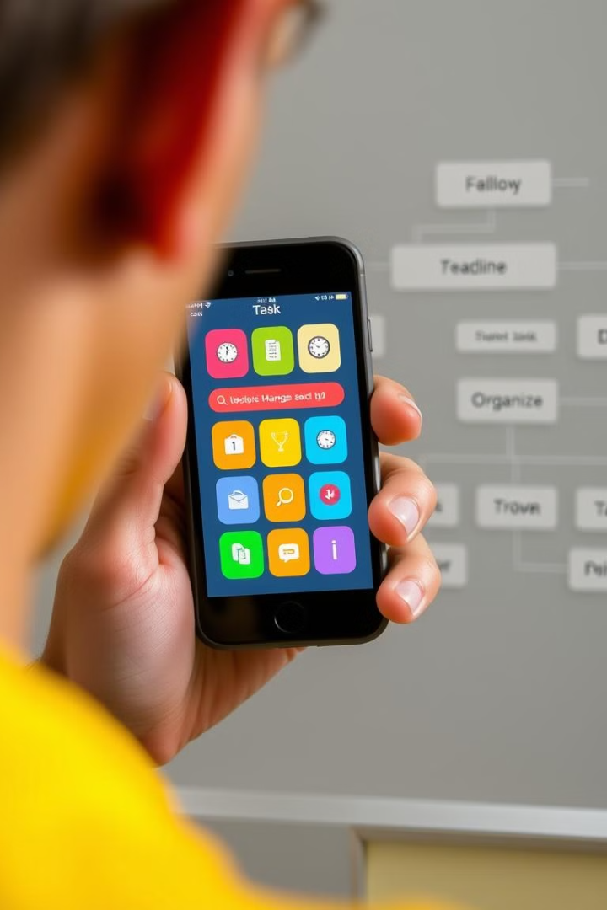
Understanding User Needs in Task Management
Efficiently managing a growing to-do list.
Prioritizing tasks based on importance and urgency.
Receiving intelligent recommendations for optimized task scheduling.

Slide 3
Core Features: Add, Remove, List, and Prioritize Tasks
Add tasks with detailed descriptions and deadlines.
Remove completed or unnecessary tasks from the list.
View a comprehensive list of all tasks with their details.
Prioritize tasks using a system of importance levels.

Slide 4
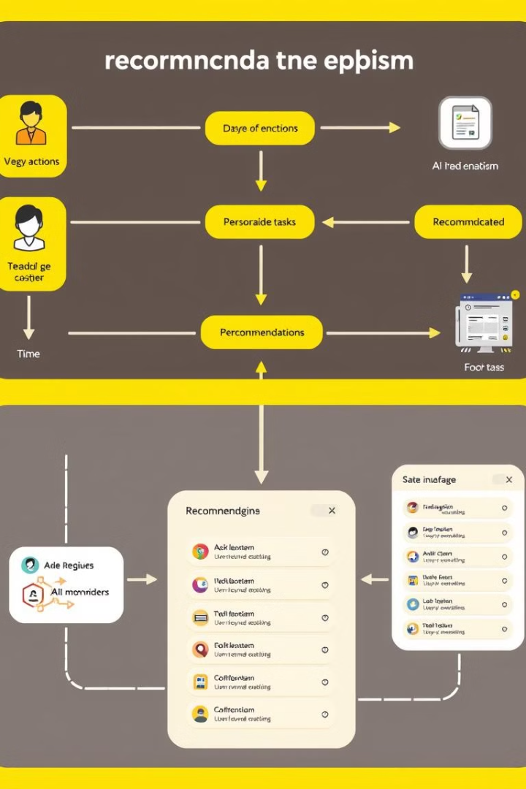
Smart Recommendation Engine for Task Optimization
Analyze task descriptions to identify patterns and relationships.
Leverage machine learning algorithms to predict task dependencies.
Provide personalized task recommendations based on priority and workflow.

Slide 5




Implementing Intuitive User Interface Design
Simple and easy to navigate.
Attractive and visually engaging design.
Clearly labeled features and functionalities.

Slide 6





Performance and Scalability Considerations
Optimized database queries for fast retrieval.
Caching mechanisms for frequently accessed data.
Load balancing techniques to distribute traffic evenly.
Scalable server infrastructure to handle growing user base.

Slide 7
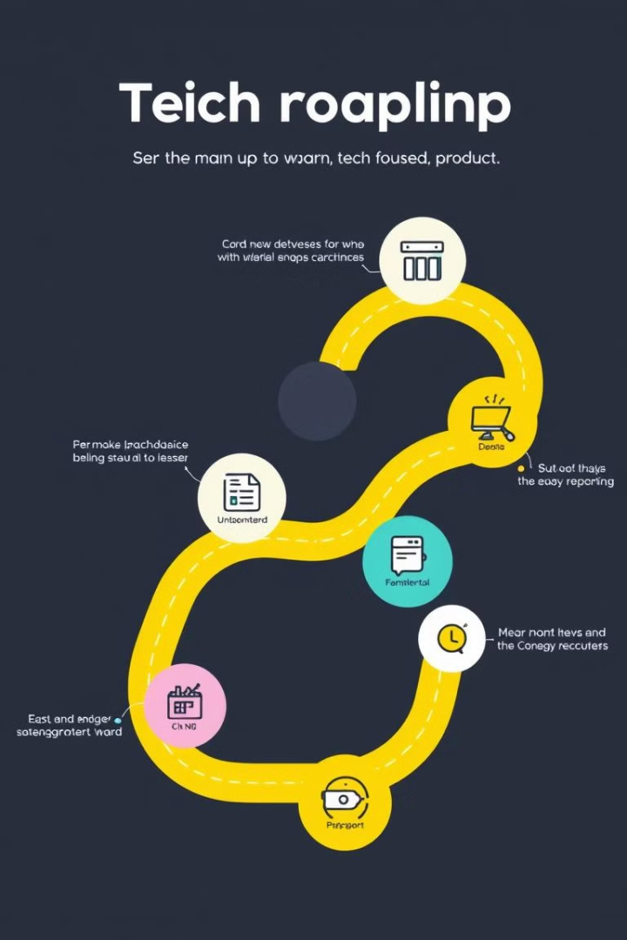
Future Roadmap and Potential Enhancements
1
Adding task automation features.
2
Implementing collaboration features for team tasks.
3
Integrating with other productivity tools.
4
Developing advanced analytics and reporting capabilities.

